Slide 1
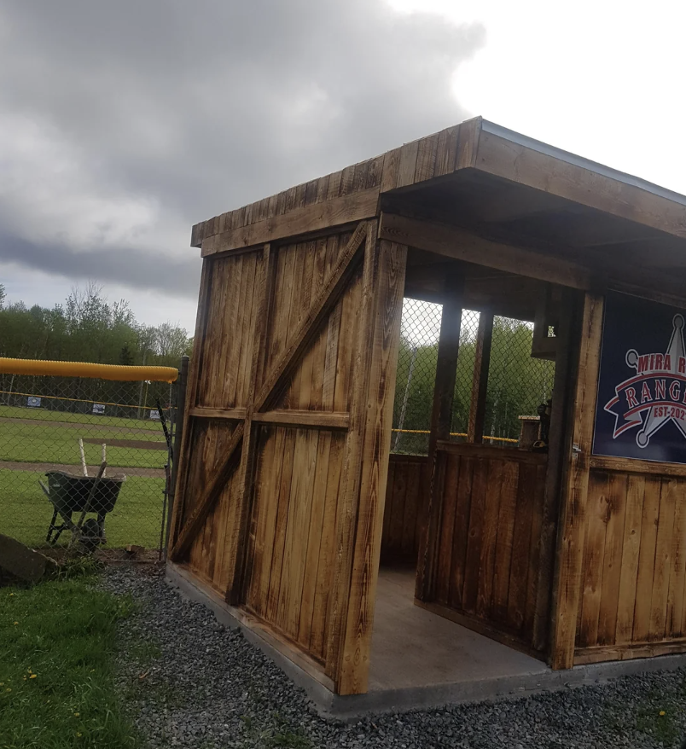
WEST HARTFORD FALCONS
2025 Season Review
Head Coach: Justin Rivera
12U Division | West Hartford, CT

Slide 2
SEASON SUMMARY
A strong year on the field
Metric | Result
Record | 13 W - 5 L
District Standing | 2nd Place
Games Played | 18
Team Batting Average | .271
Runs Scored | 97
• Best finish in three seasons, up from 4th in 2024.
• Pitching depth improved with Jayden and Brandon sharing the rotation.
• Strong contact hitting top to bottom of the order.
• Twelve players rostered, all received meaningful innings.
• Defense up the middle anchored the close wins.
West Hartford Falcons | 2025 Season Review

Slide 3
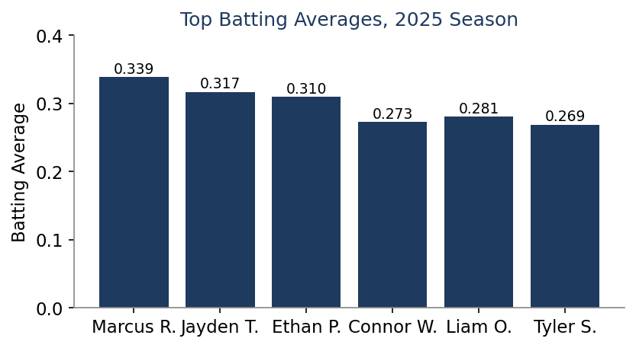
BATTING LEADERS
Who carried the offense
Player | Pos | AB | H | RBI | AVG
Marcus Rivera Jr. | SS | 62 | 21 | 12 | .339
Jayden Torres | P/3B | 60 | 19 | 11 | .317
Ethan Patel | 1B | 58 | 18 | 15 | .310
Liam Okafor | 2B | 57 | 16 | 7 | .281
Connor Walsh | CF | 55 | 15 | 8 | .273
West Hartford Falcons | 2025 Season Review

Slide 4
LOOKING AHEAD
Fall ball and the off-season
• Fall ball practices begin Thursday, October 2, 2026 at Wolcott Park, Field 3.
• Batting cage upgrades at the Rivera home planned before the spring season.
• Recruit two to three parent volunteers for field setup and dugout duty.
• Focus areas: situational hitting, base running, and lefty at-bats.
• Goal for next year: win the district and reach the regional bracket.
West Hartford Falcons | 2025 Season Review

